Slide 1

Runway Ready-An Auction Platform
A MINI PROJECT REPORT
Submitted by
Project Group:G22
VIVEK BHATT,2310992562
VRINGA GARG,2310992563
YASH CHAUHAN,2310992564
in partial fulfillment for the award of the degree
of
BACHELEOR OF ENGINEERING
in
COMPUTER SCIENCE & ENGINEERING
CHITKARA UNIVERSITY
CHANDIGARH-PATIALA NATIONAL HIGHWAY RAJPURA (PATIALA) PUNJAB-140401 (INDIA)
OCTOBER,2023

Slide 2
Group: G22
ABSTRACT
Runway Ready is an innovative online auction platform designed to simplify the process of buying and selling second-hand items. Initially developed with HTML and CSS and later enhanced with JavaScript, this project offers a user-friendly and visually engaging interface. Users can seamlessly list items and participate in real-time auctions, all while ensuring trust and security through verified seller profiles and secure payment options. Dynamic search and filtering options make item discovery effortless, and a commitment to privacy and security safeguards user data. Runway Ready redefines the second-hand marketplace, emphasizing style, simplicity, and an engaging, interactive experience. It solves common problems associated with online marketplaces, providing a trustworthy, user-friendly, and secure platform for users to connect with second-hand treasures. With a focus on innovation and user-centric design, Runway Ready aims to transform the way individuals interact with the world of second-hand items, where style meets simplicity.

Slide 3
Group: G22
TABLE OF CONTENTS
Sr. No. | Section | Page No.
1. | Introduction | 1
2. | Problem Statement | 2
3. | Technical Details | 3
4. | Key Features | 4
5. | Project Advantages | 5
6. | Results | 6
7. | Conclusion | 9

Slide 4
Group: G22
1.INTRODUCITON
This report will provide a comprehensive overview of Runway Ready, its technical underpinnings, and the innovative features that set it apart in the online marketplace landscape. We will explore how Runway Ready addresses common concerns related to trust, privacy, and the user experience, all while fostering an engaging environment for buyers and sellers alike.
We will also examine the seamless integration of HTML, CSS, and JavaScript in this project, highlighting how each of these web technologies contributes to the platform's functionality, aesthetics, and interactivity. Furthermore, we will delve into the specific challenges Runway Ready seeks to solve, emphasizing the importance of providing a reliable and secure space for users to engage in transactions.
As we journey through this report, we will gain insights into the evolution of Runway Ready, from its inception as a college project to its emergence as a potential game-changer in the world of online auctions. It is a testament to the power of technology and design in simplifying the process of buying and selling second-hand items, where style and simplicity converge to create a unique and user-friendly marketplace.

Slide 5
Group: G22
2.PROBLEM STATEMENT
Runway Ready aims to address several fundamental problem statements within the realm of buying and selling second-hand items in online marketplaces.
First and foremost, it focuses on trust and transparency, mitigating concerns related to fraud and misrepresentation. By providing verified seller profiles, secure payment options, and detailed item descriptions, Runway Ready ensures users can participate in transactions with confidence.
Moreover, the platform simplifies the user experience, eliminating the complexity often associated with online marketplaces. It provides an intuitive and user-friendly interface, making it accessible to a broad range of users, from tech-savvy individuals to those new to e-commerce.
Security is a paramount concern, and Runway Ready addresses it by implementing stringent privacy measures and safeguarding user data, including payment information.
The real-time bidding feature, powered by JavaScript, adds an interactive and competitive edge to auctions, bringing back the excitement of traditional auctions in an online format.
Additionally, personalized item recommendations streamline the process of finding the right items, making it easier for buyers to discover treasures that match their interests and style.
In summary, Runway Ready resolves key problem statements, providing a trustworthy, user-friendly, secure, and engaging platform for the buying and selling of second-hand items, where style meets simplicity.

Slide 6
Group: G22
3.TECHNICAL DETAILS
HTML Tags Used:
1. `<html>`: The root element that wraps the entire HTML document.
2. `<head>`: Contains meta information, links to external resources, and the page title.
3. `<meta>`: Provides metadata about the HTML document, such as character encoding and viewport settings.
4. `<title>`: Sets the title of the web page displayed in the browser tab.
5. `<link>`: Links to external resources, like CSS files.
6. `<style>`: Contains internal CSS styles for the page.
7. `<body>`: The main content area of the web page.
8. `<header>`: The header section of the website.
9. `<nav>`: Contains navigation links.
10. `<div>`: A generic container for structuring and styling content.
11. `<div>: Used to create navigation links.
12. `<h1>`, `<h2>`, `<h3>`, `<h4>`: Headings of various levels for structuring content.
13. `<p>`: Paragraphs for text content.
14. `<section>`: Divides the content into sections, such as the hero section and featured auctions.
15. `<a>`: Anchor tags used for hyperlinks.
16. `<img>`: Embeds images in the page.

Slide 7
CSS Styles Used:
1. CSS Reset: Styles to reset some default browser styles using the `*` selector.
2. Font Styling: Custom fonts imported from Google Fonts for headings and body text.
3. Background Colors: Background colors defined for the header, hero section, and footer.
4. Text Styling: Font size, colors, and text alignment for various elements.
5. Box Model: Styles for padding, margins, and border-radius for layout and element spacing.
6. Layout: Styles for creating a responsive layout using Flexbox or CSS Grid, as well as media queries for responsiveness.
7. Hover Effects: Transition effects for links and buttons to change appearance on hover.
8. Image Styling: Max-width and height for images to ensure responsive behavior.
9. Box Shadow: Adds a subtle shadow to elements like auction cards.
10. Animation: Hover animations for auction cards using the `:hover` pseudo-class.
11. Imports: External font import using `@import` in CSS.
These are some of the major HTML tags and CSS styles used in the Runway Ready Auction website.

Slide 8
Group: G22
4.KEY FEATURES
Key Features of the Runway Ready Auction Website (Without JavaScript):
1. User Registration and Authentication: Users can create accounts and log in securely. This allows them to access personalized features, track their bids, and manage their auctions.
2. Product Listings: Sellers can list fashion items and accessories for auction. Each listing includes detailed product information, images, and bidding options.
3. Auction Bidding: Registered users can place bids on listed items. The system handles real-time bidding, updating the current bid amount, and notifying users of competing bids.
4. Featured Auctions: The platform highlights featured auctions on the homepage to attract user attention to select items.
5. User Dashboard: Users can access a personalized dashboard where they can view their active bids, watchlist items, and transaction history.
6. Search and Filter: Users can search for specific items and filter results based on categories, price range, and other parameters.
7. Performance Optimization: To provide a fast and efficient experience, the site is optimized for performance through techniques like image compression and code minification.
8. Custom Styling: The site features custom styling, creating a visually appealing and unique user interface.
These key features provide a comprehensive and user-friendly online auction platform without the need for JavaScript implementation.

Slide 9
Group: G22
5.PROJECT ADVANTAGES IN FUTURE
1. Making Money: For those who create the platform, it can be a way to make a lot of money. They can earn money when people list items for sale and when auctions are successful.
2. More Customers: Many people who love fashion and unique items can use this platform. This means more people can join and use it, which is good for the business.
3. Enjoyable Experience: Users will like the platform because they can bid in real time, talk to sellers, and keep track of their activity. It will make users happy, and they will keep using it.
4. Trustworthy: Over time, the platform will become a trusted place for fashion auctions. People will know it's a good place to buy and sell fashion items.
6. Learning from Data: The platform can use data to learn about what people like and don't like. This information helps make the platform better in the future.
7. Helping the Earth: By promoting the reuse of fashion items, the platform can help the environment. It's good for the planet.
8. Unique Items: The platform can be known for selling unique and vintage fashion items. This attracts people who want special and one-of-a-kind things.

Slide 10
Group: G22
6.RESULTS
1. More Users: Many people will use the website, and more will join over time. This is good because it means lots of people will be using the website.
2. Trusted Place: As time goes on, people will trust the website to buy and sell fashion items. It becomes a place where people know they can do business safely.
3. Helping the Environment: By using the website, people can help the planet by reusing things instead of throwing them away. It's good for the Earth.
4. Unique Items: The website can be known for selling special and old-fashioned fashion items. This attracts people who want something that's different from what everyone else has.
5. Lots of Users Worldwide: Since the website is online, people from all around the world can use it. It can become a big place for fashion lovers.
6. Famous and Important: By working with famous people and organizations, the website can become even more important in the fashion world.
7. Make Friends: People can make friends and talk to each other. It's like a group where they feel like they belong.

Slide 11
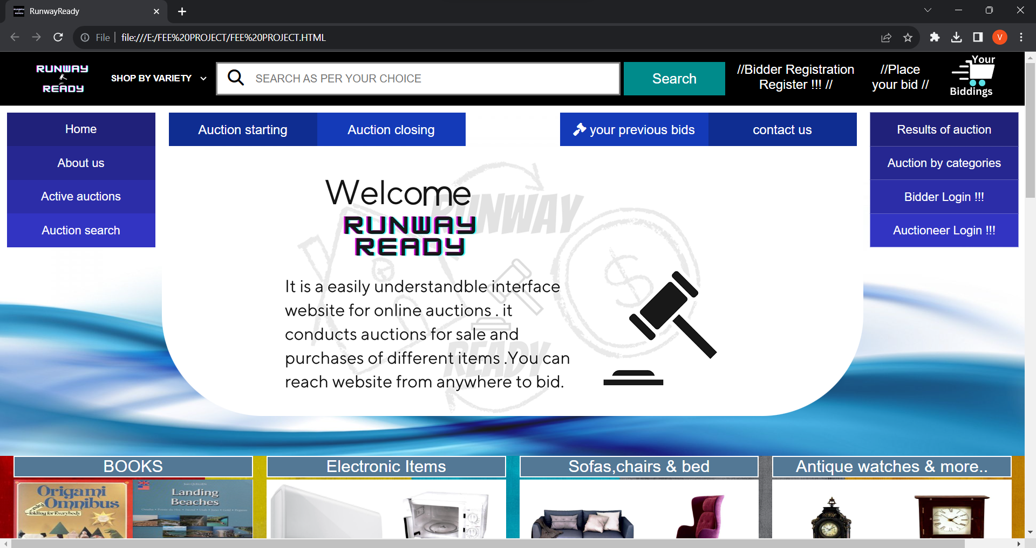
MAIN PAGE
SEARCH BAR/MAIN NAV
VIDEO EMBEDED AT THE CENTER OF PAGE
OTHER NAV’S

Slide 12
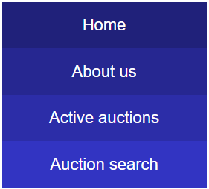
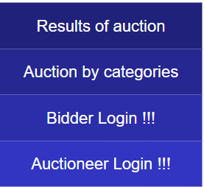
MAIN NAV
NAV-BARS
CENTER NAV
NAV1
NAV2

Slide 13
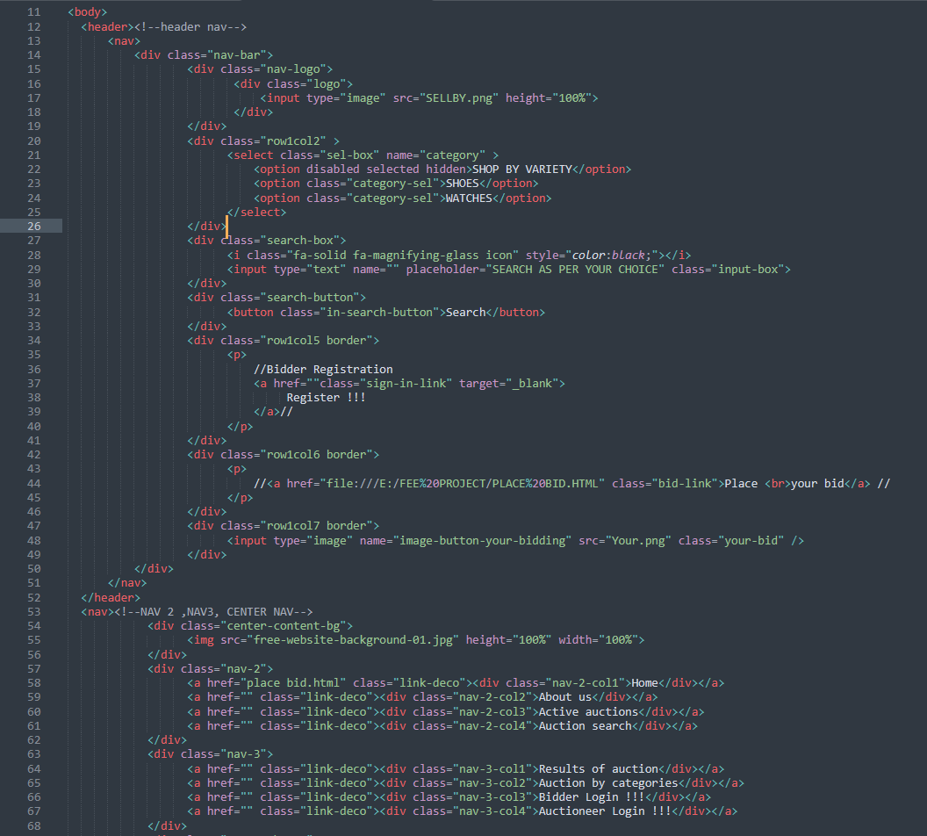

CODE FOR CREATING NAV BAR- MAIN NAV,NAV1,NAV2,CENTER NAV 1.HTML

Slide 14
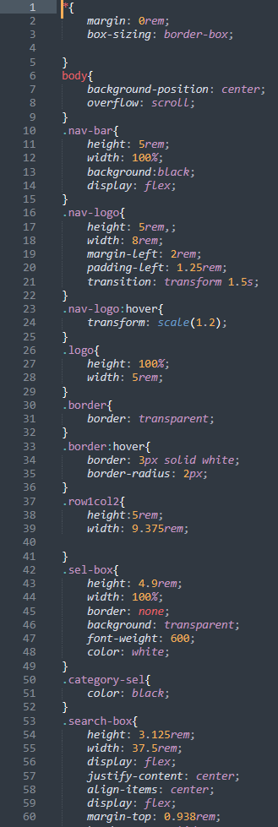
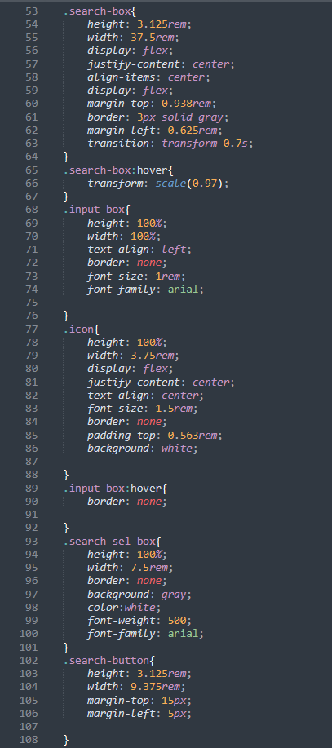
2.CSS
1
2

Slide 15
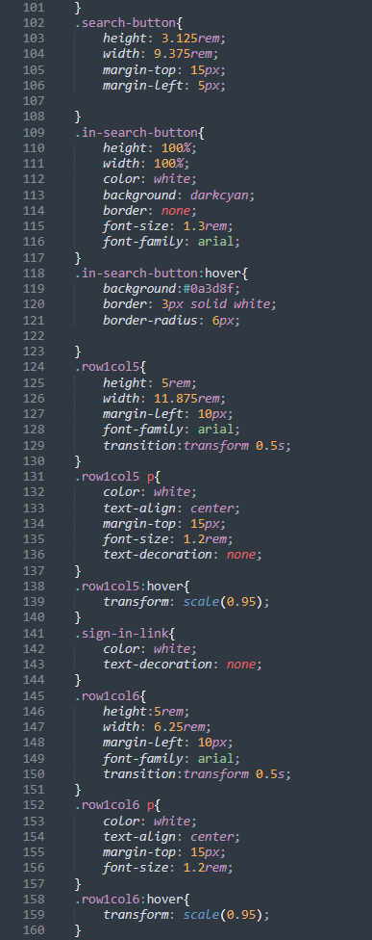
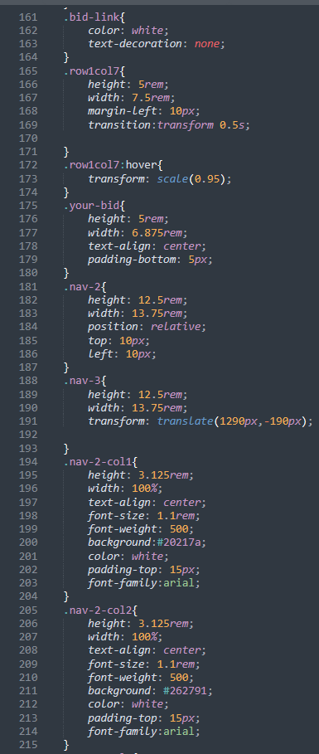
3
4

Slide 16
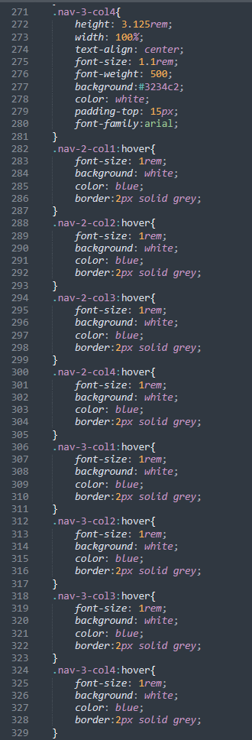
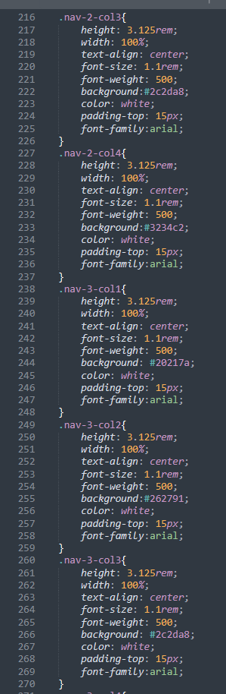
6
5

Slide 17
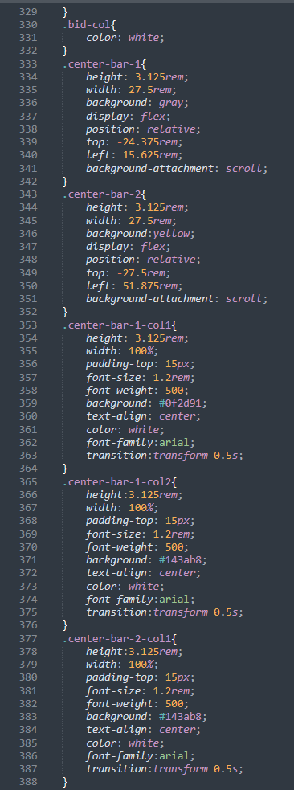
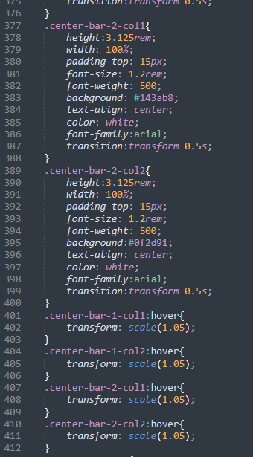
7
8

Slide 18

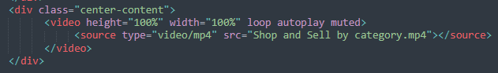
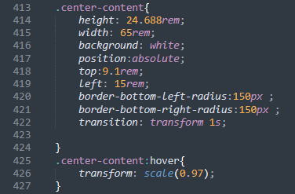
VIDEO EMBEDED IN CENTER
HTML CODE
CSS CODE

Slide 19
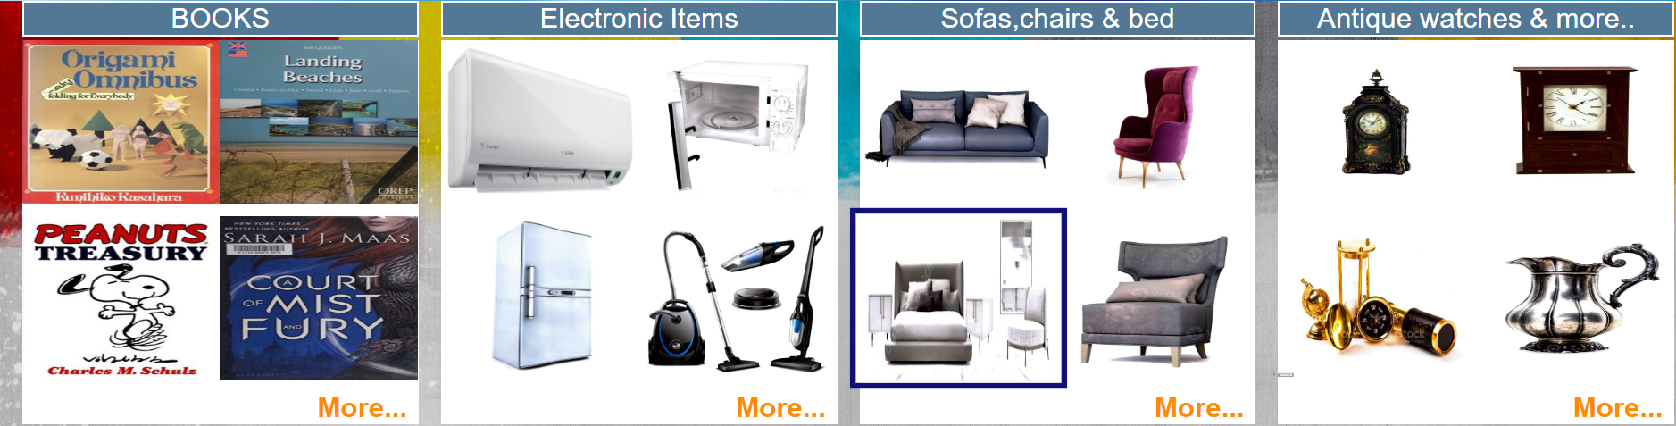
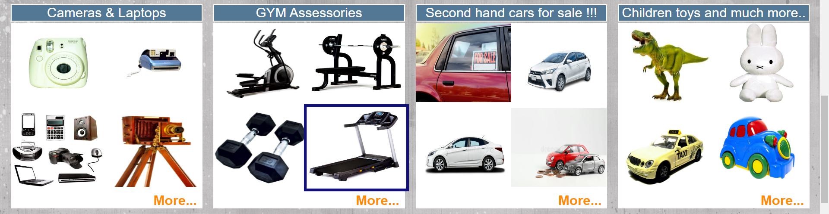
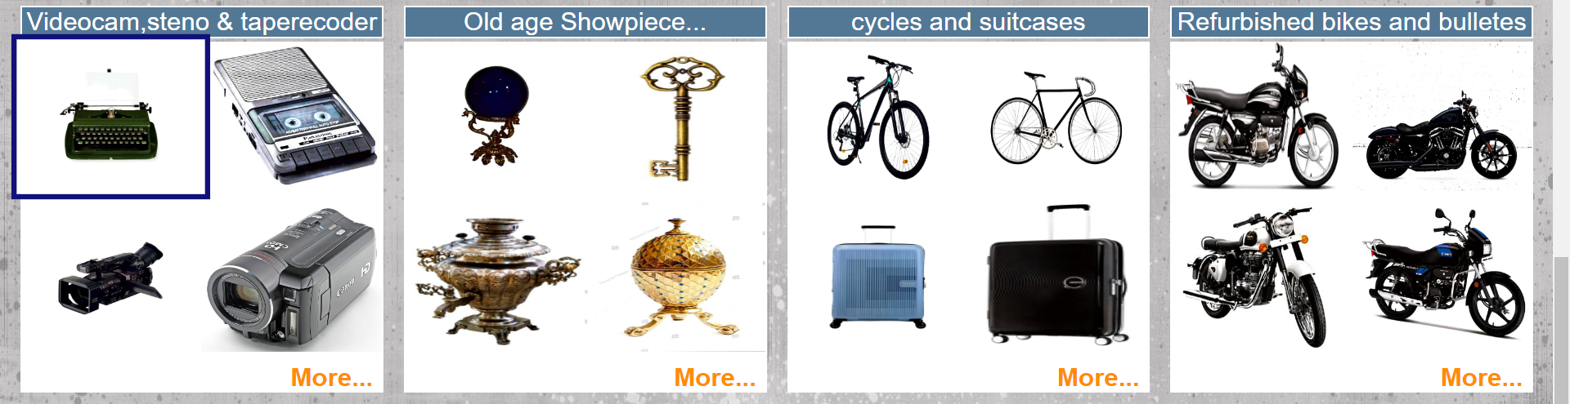
CATEGOREIS SECTION IN THIS SECTION WE MAKE CODE OF ONE ROW AND IMPLIMENT IT 3 TIMES BUT IMAGE SOURCE CHANGES IN EACH

Slide 20
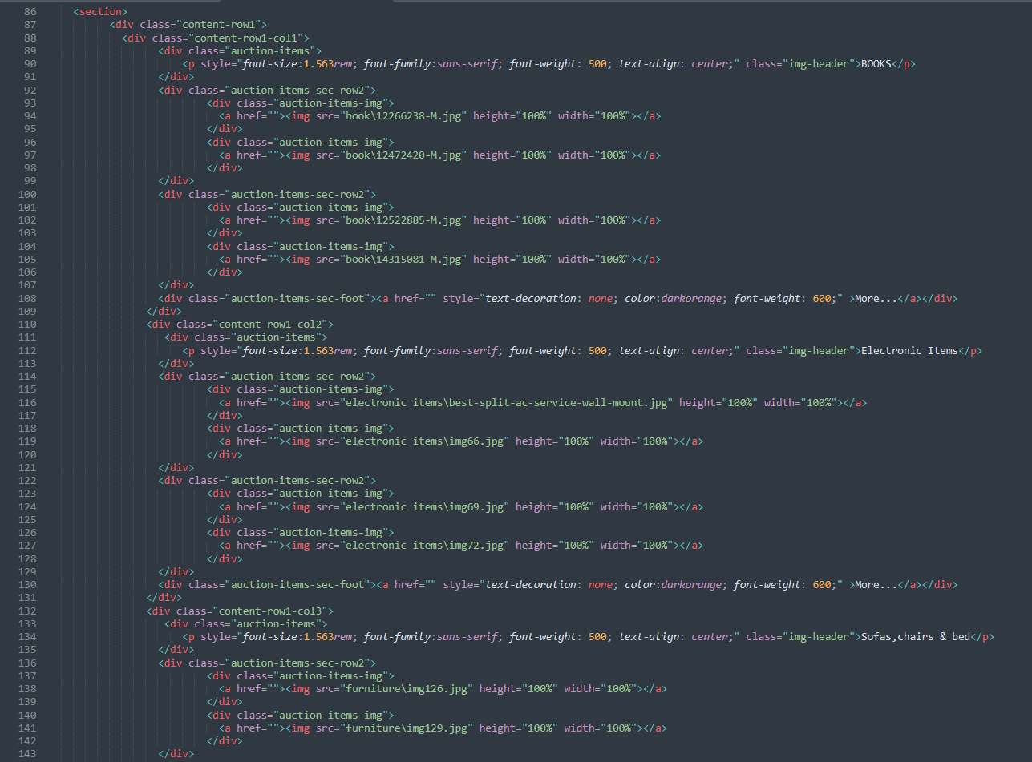
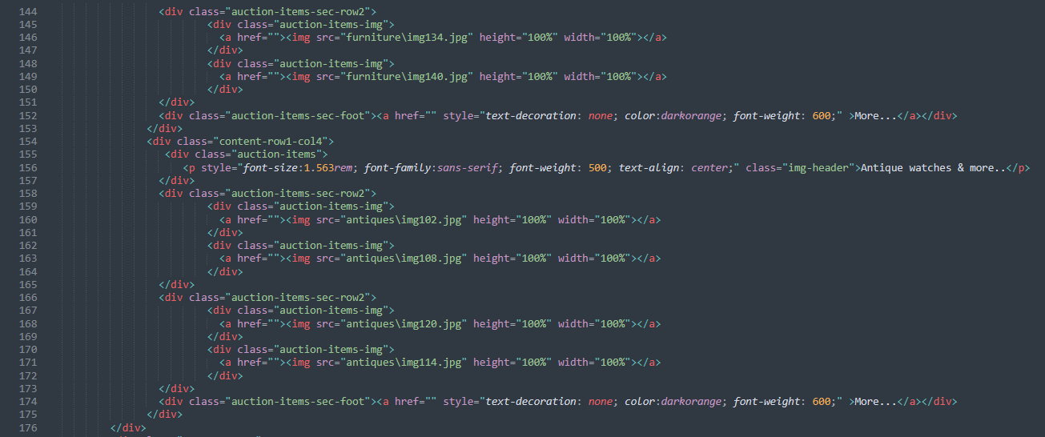
CATEGORIES SECTION 1.HTML CODE

Slide 21
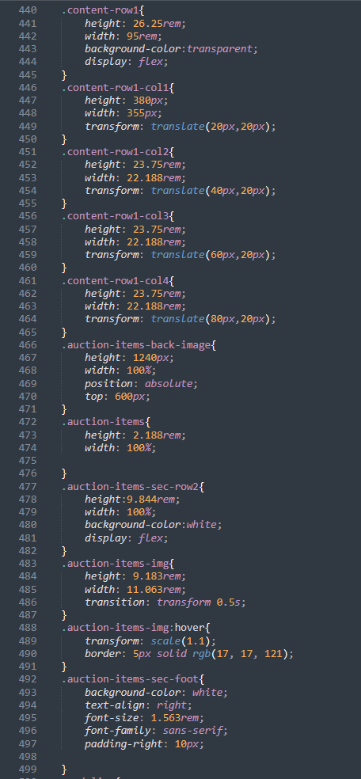
CATEGORES SECTION 2.CSS

Slide 22
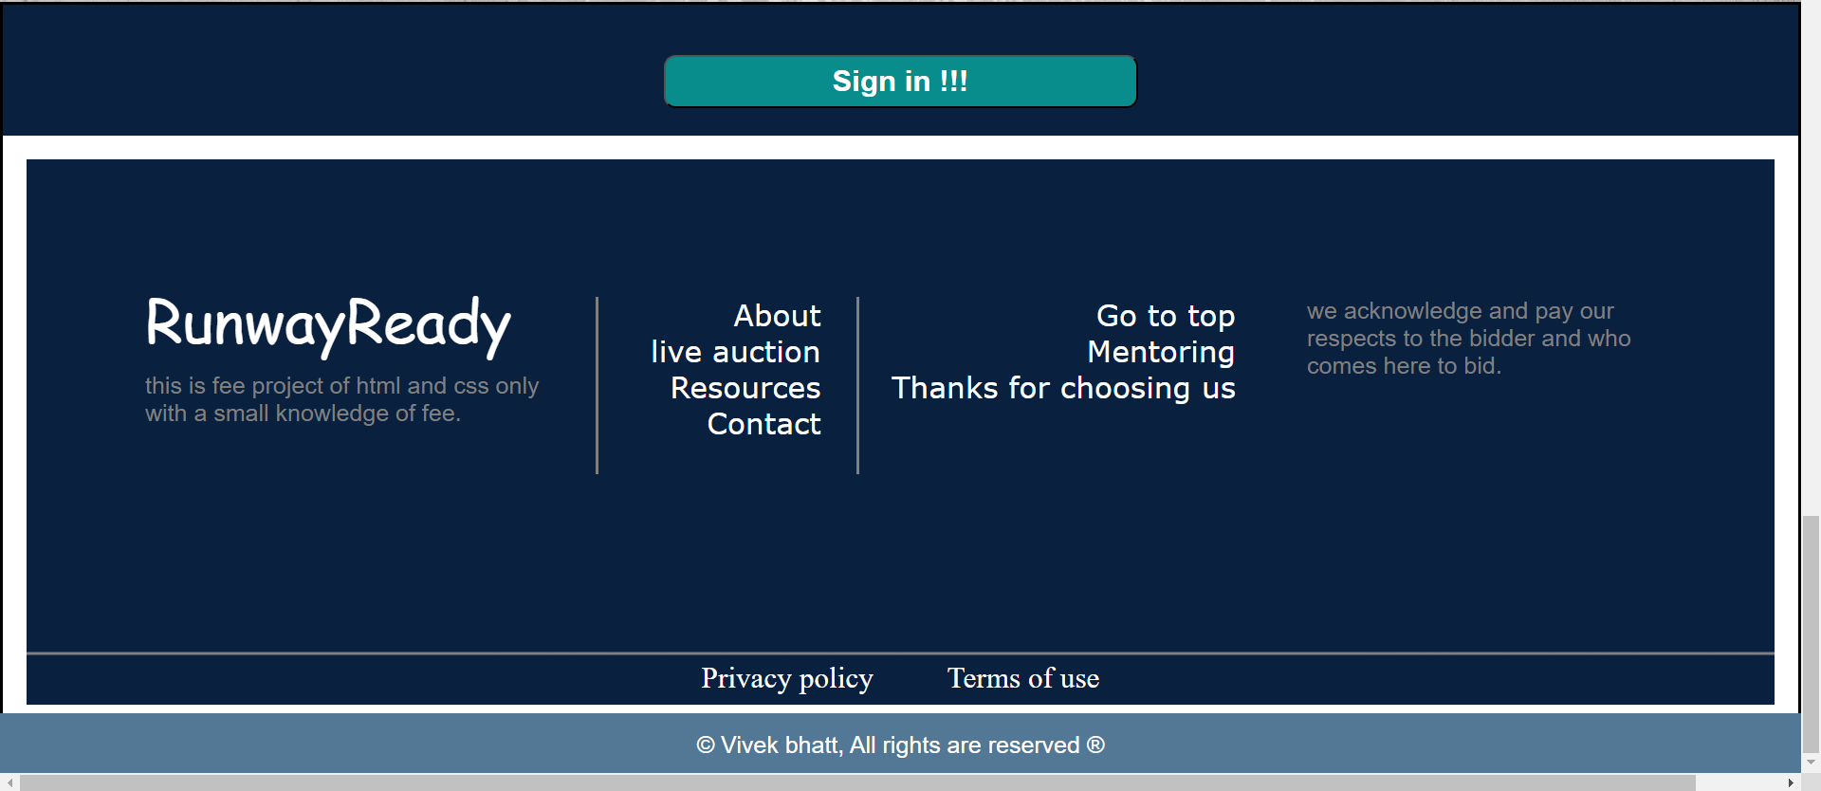
FOOTER SECTION

Slide 23
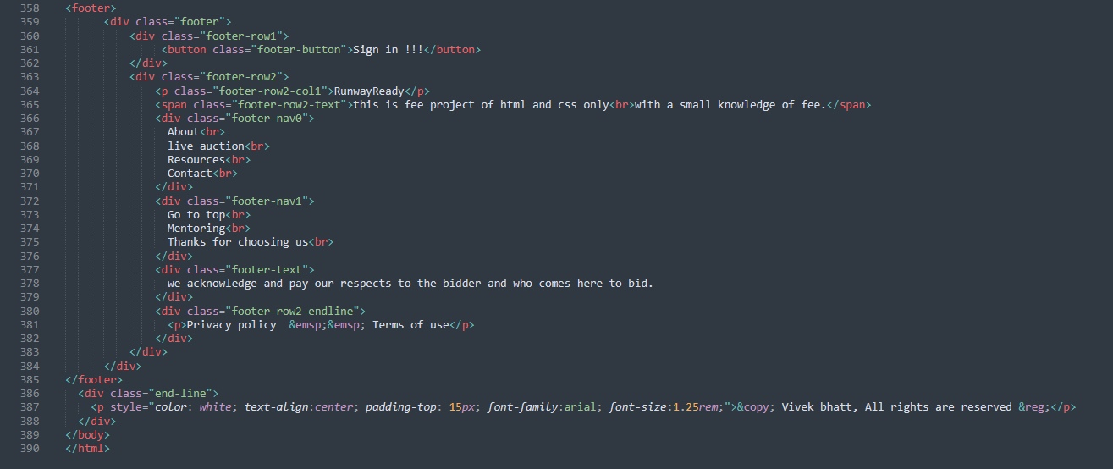
FOOTER SECTION 1.HTML

Slide 24
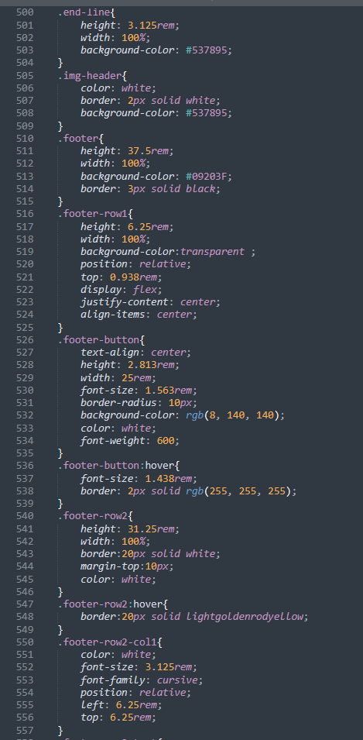
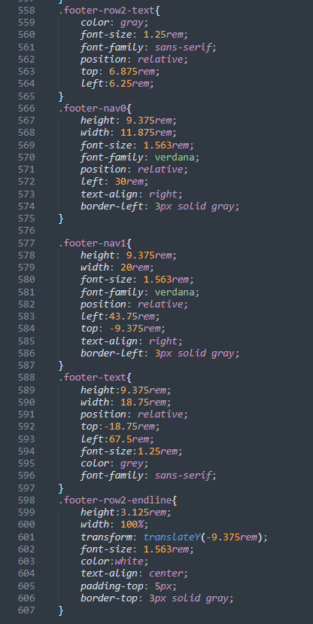
FOOTER SECTION 2.CSS

Slide 25
Group: G22
7.CONCLUSION
1. Building a Great Website: We created a website called Runway Ready Auction. It's like an online store where people can buy and sell cool fashion items.
2. Good for Business: This website can make money for the people who made it. They earn money when people sell things and when auctions are successful.
3. Easy to Use: We made the website easy to use. People can sign up, log in, and start bidding on fashion items they like.
4. Lots of People: Over time, more and more people will join the website. That's great because it means more people will be able to use it..
10. Global Reach: People from all over the world can use the website. It's like a global club for fashion lovers.
11. Innovation: The website can get better with new features and ideas. For example, people might be able to try on clothes virtually.
12. Community: People can make friends and talk to each other on the website. It's like a friendly group for fashion enthusiasts.

Slide 26
REFERENCE
FONT AWESOME-for using icons like search icon, cart icon etc.
CANVA- used to create logo or some images.
PINTREST – used to make site beautiful by using images of pintrest.
REFERENCE LINKS
https://fontawesome.com/
https://www.canva.com/
https://in.pinterest.com/

